Slide 1
Decision Tree Algorithm
Dr. Shamim Al Mamun
Associate professor
Institute of information technology
Jahangirnagar university

Slide 2
What is decision Tree?
A decision tree is a tree where each node represents a feature(attribute), each link(branch) represents a decision(rule) and each leaf represents an outcome(categorical or continues value).

Slide 3
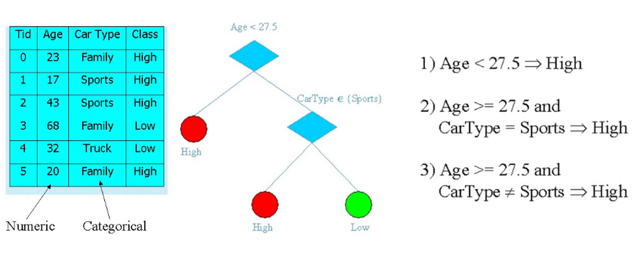

Slide 4
Algorithms for creating decision tree
CART (Classification and Regression Trees)
→ uses Gini Index(Classification) as metric.
ID3 (Iterative Dichotomiser 3)
→ uses Entropy function and Information gain as metrics.

Slide 5
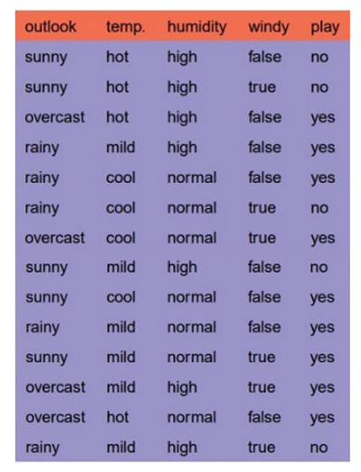

Slide 6
which one do we need to pick first?
Determine the attribute that best classifies the training data; use this attribute at the root of the tree. Repeat this process at for each branch.
This means we are performing top-down, greedy search through the space of possible decision trees.

Slide 7
how do we choose the best attribute?
use the attribute with the highest information gain in ID3
In order to define information gain precisely, we begin by defining a measure commonly used in information theory, called entropy that characterizes the (im)purity of an arbitrary collection of examples.”

Slide 8
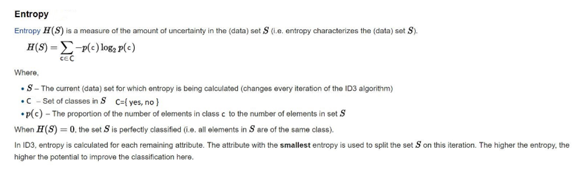
Entropy

Slide 9
For a binary classification problem
If all examples are positive or all are negative then entropy will be zero i.e, low.
If half of the examples are of positive class and half are of negative class then entropy is one i.e, high.

Slide 10
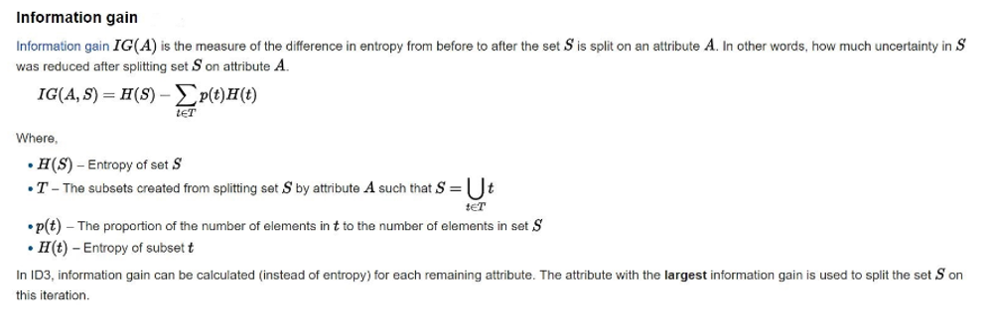
Information Gain

Slide 11
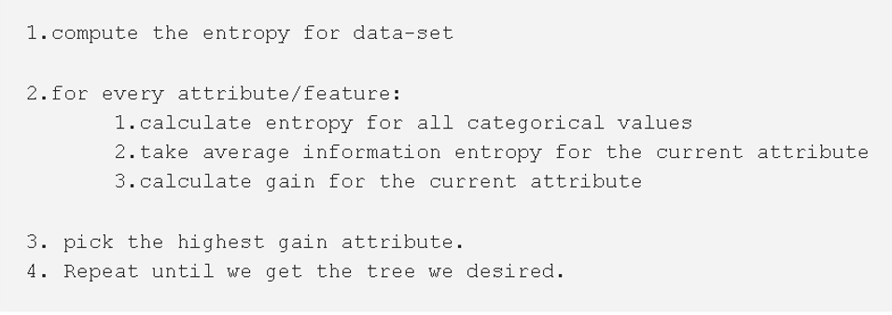
Algorithm

Slide 12
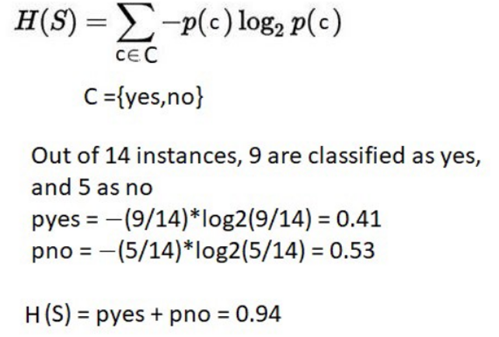

Slide 13
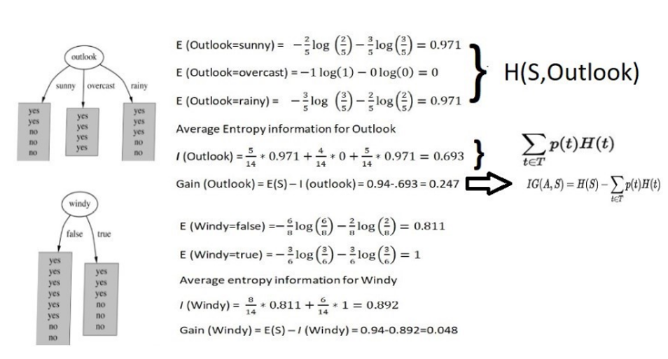

Slide 14
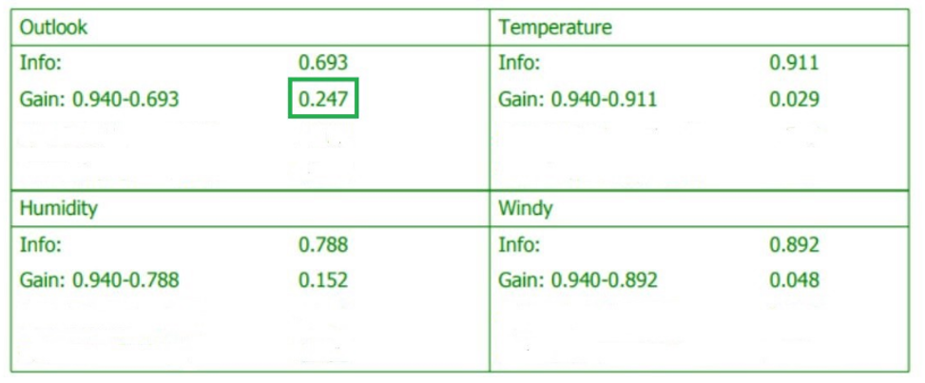

Slide 15
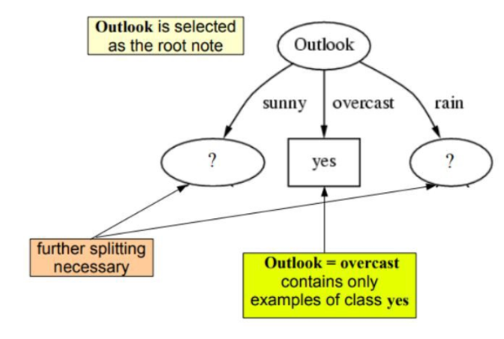

Slide 16
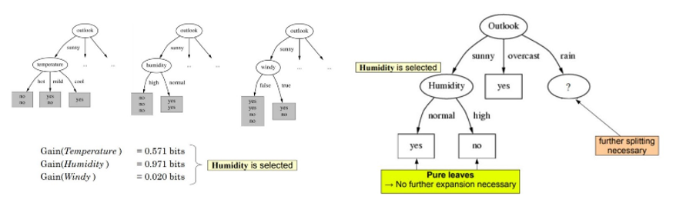

Slide 17
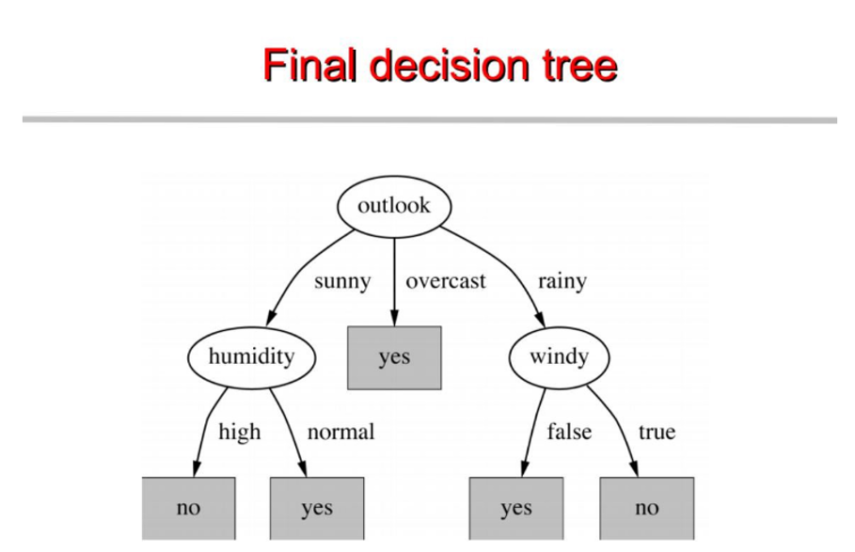

Slide 18
For CART algorithm Gini Index is used
Assignment2:
Find the decision tree using Gini index calculation.
For help use the following link:
https://www.geeksforgeeks.org/decision-tree-introduction-example/

